Slide 1







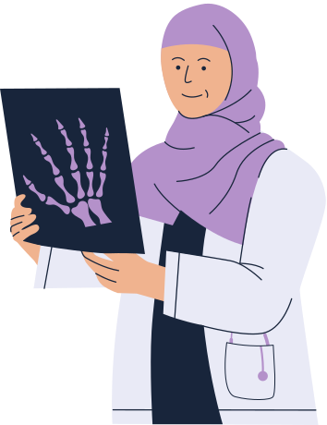


DOCTOR’S
APPOINTMENT
PRESENTED BY:
1
AMRAH IMTIAZ
MUHAMMAD TAHIR

Slide 2
INTRODUCTION:
●The doctor's appointment system.
●This program will use CPU scheduling algorithm to manage doctor's appointment efficiently.
2

Slide 3

PROBLEM
STATEMENT
●The health sector is faced with challenges to effectively book appointments.
●Manual scheduling systems fail to prioritize emergency cases.
●Patient dissatisfaction is significantly increased by extended waiting times and delays in medical care.
3

Slide 4
OBJECTIVES
OBJECTIVE 01
OBJECTIVE 02
●Automating scheduling, a system should be developed to schedule doctor appointments.
Apply the first-come, first-served (FCFS) algorithm for normal appointments
OBJECTIVE 03
OBJECTIVE 04
●Apply a priority-based preemptive algorithm to allow emergency appointments.
●Set up the system to be deployed on Ubuntu Linux.
4

Slide 5


TOOLS AND TECHNIQUES
5

Slide 6
●Take the patient's input for personal information and categorize their medical condition.
IMPLEMENTATION
●Normal appointments are assigned an ID implementing a first-come, first-served (FCFS) algorithm.
●Emergency cases are assigned an ID based on a priority-based preemptive algorithm.
6

Slide 7
CONCLUSION:
●The Doctor's Appointment System project addresses scheduling challenges in healthcare.
●This project aims to learn operating system concepts, specifically CPU scheduling algorithms.
●System automates appointments, reduces wait times, ensures timely care.
7

Slide 8
Thank you for your attention
8

